Slide 1
AI-Assisted, FNA-Based Breast Cancer Screening Approach
Team 3:
Abhinav Aggarwal, Jennifer Tsang, Kevin Dong,
Lila Chan, William Lee

Slide 2
~24,000
People in BC require diagnostic follow-up
after abnormal breast screenings each year
BC Cancer. (2025, September). BC Cancer Breast Screening: 2023 Program Results. https://www.bccancer.bc.ca/screening/Documents/Breast-Screening-Program-Report-2023.pdf

Slide 3
Problem Statement
People in BC with abnormal palpable breast findings on physical exam or mammography are experiencing delays in accessing breast biopsy services leading to worse mortality, and financial and emotional burden.

Slide 4
Patient Impact
Increased Mortality
Financial Burden
Emotional Burden
A 4-week delay in receiving a positive biopsy results in a 20% increase in mortality
Rural tax: $856 for transport, $674 for accommodation, plus hidden costs
Patients with longer wait times experience greater pre-biopsy anxiety

Slide 5
Data Description
559
10
10
20
Training Samples
Demo Samples
Morphological traits
Additional features
63% Benign
73% Malignant
50% Benign
50% Malignant
Radius, Concavity, Symmetry …
Standard Error,
‘Worst'/ largest values

Slide 6


3 ML Models
Supervised:
XGBoost Classification
Unsupervised:
Global
Clustering
Unsupervised:
Malignant
Clustering

Slide 7
Model 1: Supervised Learning
XGBoost model: 80-20 training split
Achieved a 95% sensitivity, and 97% overall accuracy
Limitations:
5% false negative rate (2 cases)
Black-box model
Need to see why the AI made its choice

Slide 8
Model 2: Unsupervised Learning
Principal Component Analysis (PCA):
Reduce number of features from 30 → 2
Gaussian Mixture Models (GMMs):
Prediction probabilities for each cluster
Provide soft predictions for Benign / Malignant

Slide 9
Model 3: Unsupervised Learning
Principal Component Analysis (PCA):
Reduce 30 features down to 2
Gaussian Mixture Models (GMMs):
Prediction probabilities for each cluster
GMM as an Anomaly Detector:
Trained only on Malignant cases:
Learns morphological features
Flags the case as atypical

Slide 10
Triple-Validation System
Model 1 (XGBoost) predicts 'Benign'
Patient is sitting inside a Malignant territory (Model 2) on the map
The clinician is alerted to catch the AI’s mistake

Slide 11
Demo
https://jentsang-breast-cancer-diagnostic.share.connect.posit.cloud/

Slide 12
Data Limitations
Binary groupings, does not discriminate between grades or subtypes
Lack of clinical context
Outdated and small dataset

Slide 13
Bringing Mainstreaming to Breast Cancer Screening

Slide 14
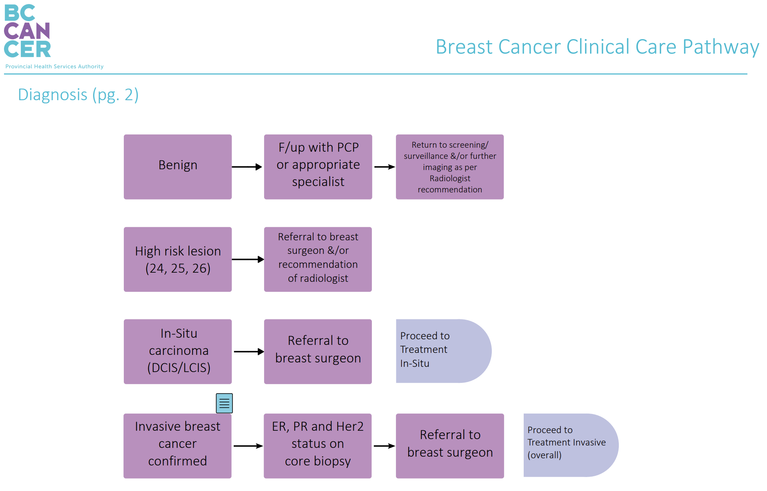
Risk Stratification of Suspected Cancer
Benign
Low-Risk Cytology
Core Needle Biopsy
Proposed changes
Medium-Risk Cytology
Core Needle Biopsy
High-Risk Cytology
Core Needle Biopsy
BC Cancer. (2024, August). Breast Cancer Clinical Care Pathway. https://www.bccancer.bc.ca/health-professionals/clinical-resources/clinical-care-pathways/tumour-specific-pathways

Slide 15
Reduction in Overtreatment
Increased positive predictive value
Decreased costs to healthcare system
Decreased wait times for biopsy

Slide 16
Future Directions
Feature weighting to more accurately risk stratify based on the most important prognostic features of cell nuclei
Bayesian analysis to incorporate pre-test probability from prior physical exam or mammography findings
Expanding the dataset

Slide 17
References
BC Cancer. (2023). Breast screening program report 2023. https://www.bccancer.bc.ca/screening/Documents/Breast-Screening-Program-Report-2023.pdf
BC Cancer. (2023). Breast clinical pathway (Version 2). https://www.bccancer.bc.ca/books/Documents/Clinical%20Care%20Pathways/Breast%20Clinical%20Pathway_Published_V2.pdf
BC Ministry of Health. (n.d.). Breast biopsy wait times. https://swt.hlth.gov.bc.ca/WaitTimesResults.xhtml?rollupProcedure=20&procName=Breast+Biopsy&adult=Y
Basu, A., & Garg, R. (1993). Nuclear pleomorphism and prognosis in breast cancer. Journal of Surgical Oncology, 53(1), 1–5. https://pubmed.ncbi.nlm.nih.gov/8369525/
Government of British Columbia. (n.d.). Rural development: Draft guidance. https://www2.gov.bc.ca/assets/gov/employment-business-and-economic-development/rural-initiative/rural_initiative_-_draft_guidance.pdf
Gorey, K. M., Luginaah, I. N., Holowaty, E. J., Fung, K. Y., & Hamm, C. (2013). Breast cancer survival in Canada and the USA: Meta‑analytic evidence of a Canadian advantage in low‑income areas. International Journal of Epidemiology, 42(3), 932–946. https://pubmed.ncbi.nlm.nih.gov/22338328/
Hatch, S., et al. (2021). Out‑of‑pocket costs for rural patients traveling for medical care in British Columbia. Healthcare Policy, 17(1), 62–75. https://pubmed.ncbi.nlm.nih.gov/34419025/
Khan, M. A., et al. (2015). Anxiety levels in women awaiting breast biopsy. Journal of the College of Physicians and Surgeons Pakistan, 25(10), 743–746. https://pubmed.ncbi.nlm.nih.gov/26424811/
Kong, A. L., et al. (2024). Negative biopsy rates in breast surgery: A national analysis. JAMA Surgery. https://jamanetwork.com/journals/jamasurgery/fullarticle/2813028?utm_source=openevidence&utm_medium=referral
Li, X., et al. (2025). Impact of biopsy delay on mortality in breast cancer: A meta‑analysis. The Breast. https://pubmed.ncbi.nlm.nih.gov/40490647/

